Slide 1



Change
the way you pay.
Mobile Banking Made Simple. Payments made easy.

Slide 2



The Package
1
Payment Solutions
Our Approach
Pricing Proposal
2
3

Slide 3
1
Payment Solutions

Slide 4

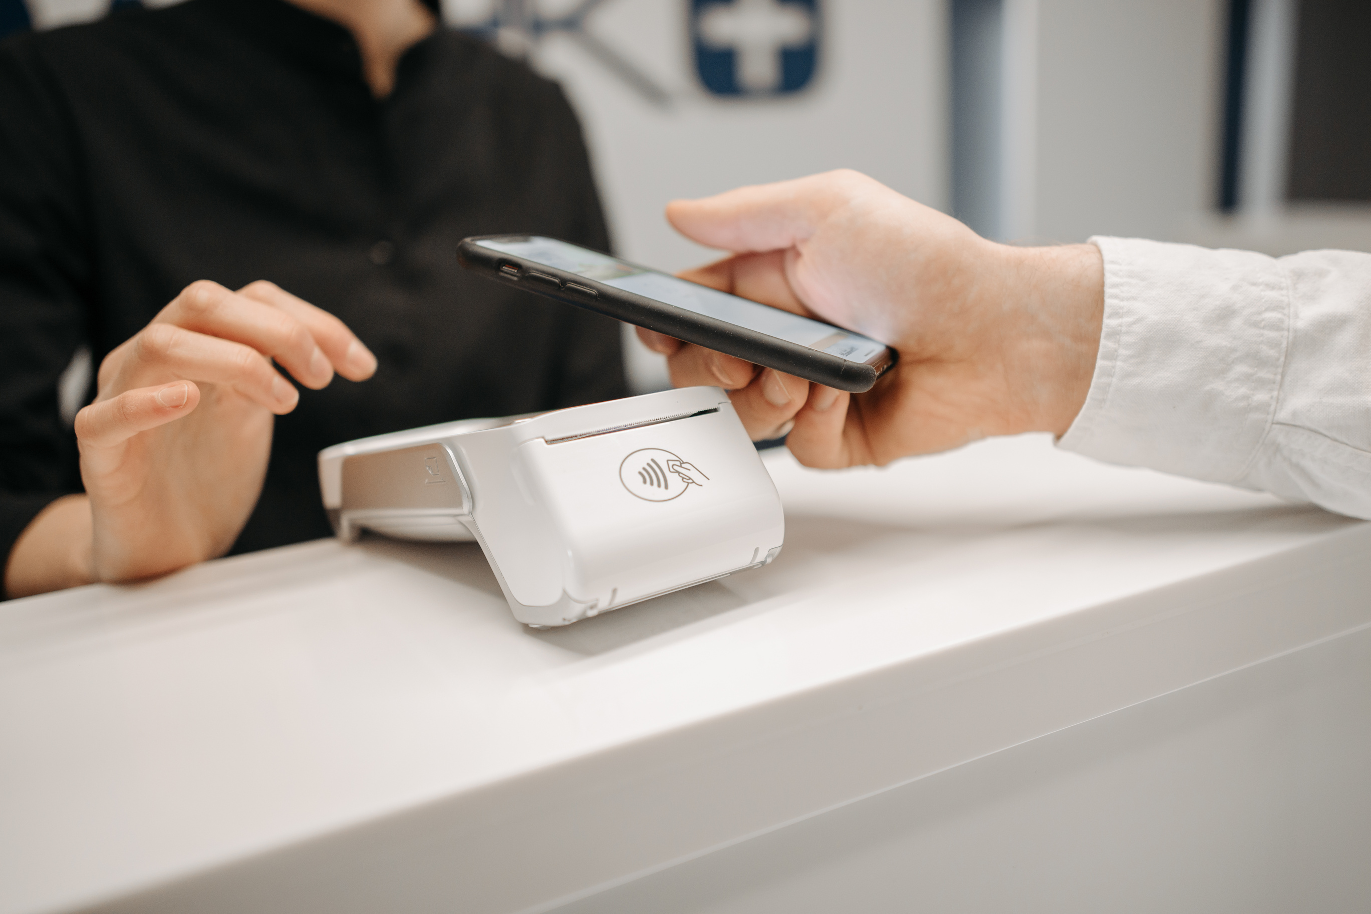

Mobile Banking Made Simple.
PayWise Limited is Trinidad & Tobago's first electronic money issuer registered with the Central Bank of Trinidad and Tobago. We are revolutionizing the way you make payments and earn rewards. Since our registration, we've been building a comprehensive digital payment ecosystem that empowers businesses and individuals with secure, real-time payment solutions.
An electronic money issuer registered with the Central Bank of Trinidad and Tobago and with the Financial Intelligence Unit of Trinidad and Tobago as a Listed Business
A trusted partner serving thousands of users across Trinidad & Tobago, creating a thriving digital payment ecosystem that supports diverse payment types and instruments, enabling simplified transaction management in local currency, backed by strong compliance and regulatory solutions that power seamless fund transfers locally and internationally.

Slide 5

Real-time Digital Payments & Money Movement for Everyone
Digital Wallet & Payment Solutions
Traditional cash-based payment systems are slow, inconvenient, and limit business growth opportunities. The PayWise platform removes complexity and enables seamless digital payments through our comprehensive mobile banking solution.
Features:
  Instant payments between PayWise users
  QR Code payments for contactless transactions
  ePOS integration for business payments
  LINX machine compatibility for card payments
  Bill payment services (utilities, phone top-ups)
  Business invoicing and payment collection
  Agent network for cash-in/cash-out services
  Robust API platform for business integrations
  Real-time transaction notifications
  Comprehensive transaction history and reporting

Slide 6
Fund Flow Process
1
2
3
Customer initiates payment through PayWise app, QR scan,
or ePOS
Transaction processed
through our secure platform with real-time verification
Instant confirmation
and notification sent to both parties
6
5
4
Automated
reconciliation and reporting for businesses
Comprehensive transaction
data available on platform dashboard
Funds transferred immediately to recipient's account

Slide 7

Business Payment Solutions
For Small Businesses to Large Enterprises
Accept payments with ease through multiple channels and grow your business with PayWise's comprehensive business solutions.
Features:
  QR Code payment acceptance - no hardware required
  ePOS integration for seamless checkout experiences
  Physical LINX machine support for card payments
  Invoice generation and automated payment collection
  Customer payment requests with automated reminders
  Real-time sales tracking and analytics
  Next business day payout to business bank accounts
  Multi-location support for chain businesses
  Bulk payments
  Split payments and payouts
  Comprehensive reporting and analytics dashboard

Slide 8
Fund Flow Process:
1
2
3
4
Customer selects PayWise payment option at checkout
Business generates payment request via app, QR, or ePOS
Customer
completes payment using preferred method
Real-time
payment confirmation to business
7
6
5
Business accesses comprehensive
transaction data
Automated reconciliation
and detailed reporting
Funds available
immediately in business account

Slide 9
2
Our Approach

Slide 10
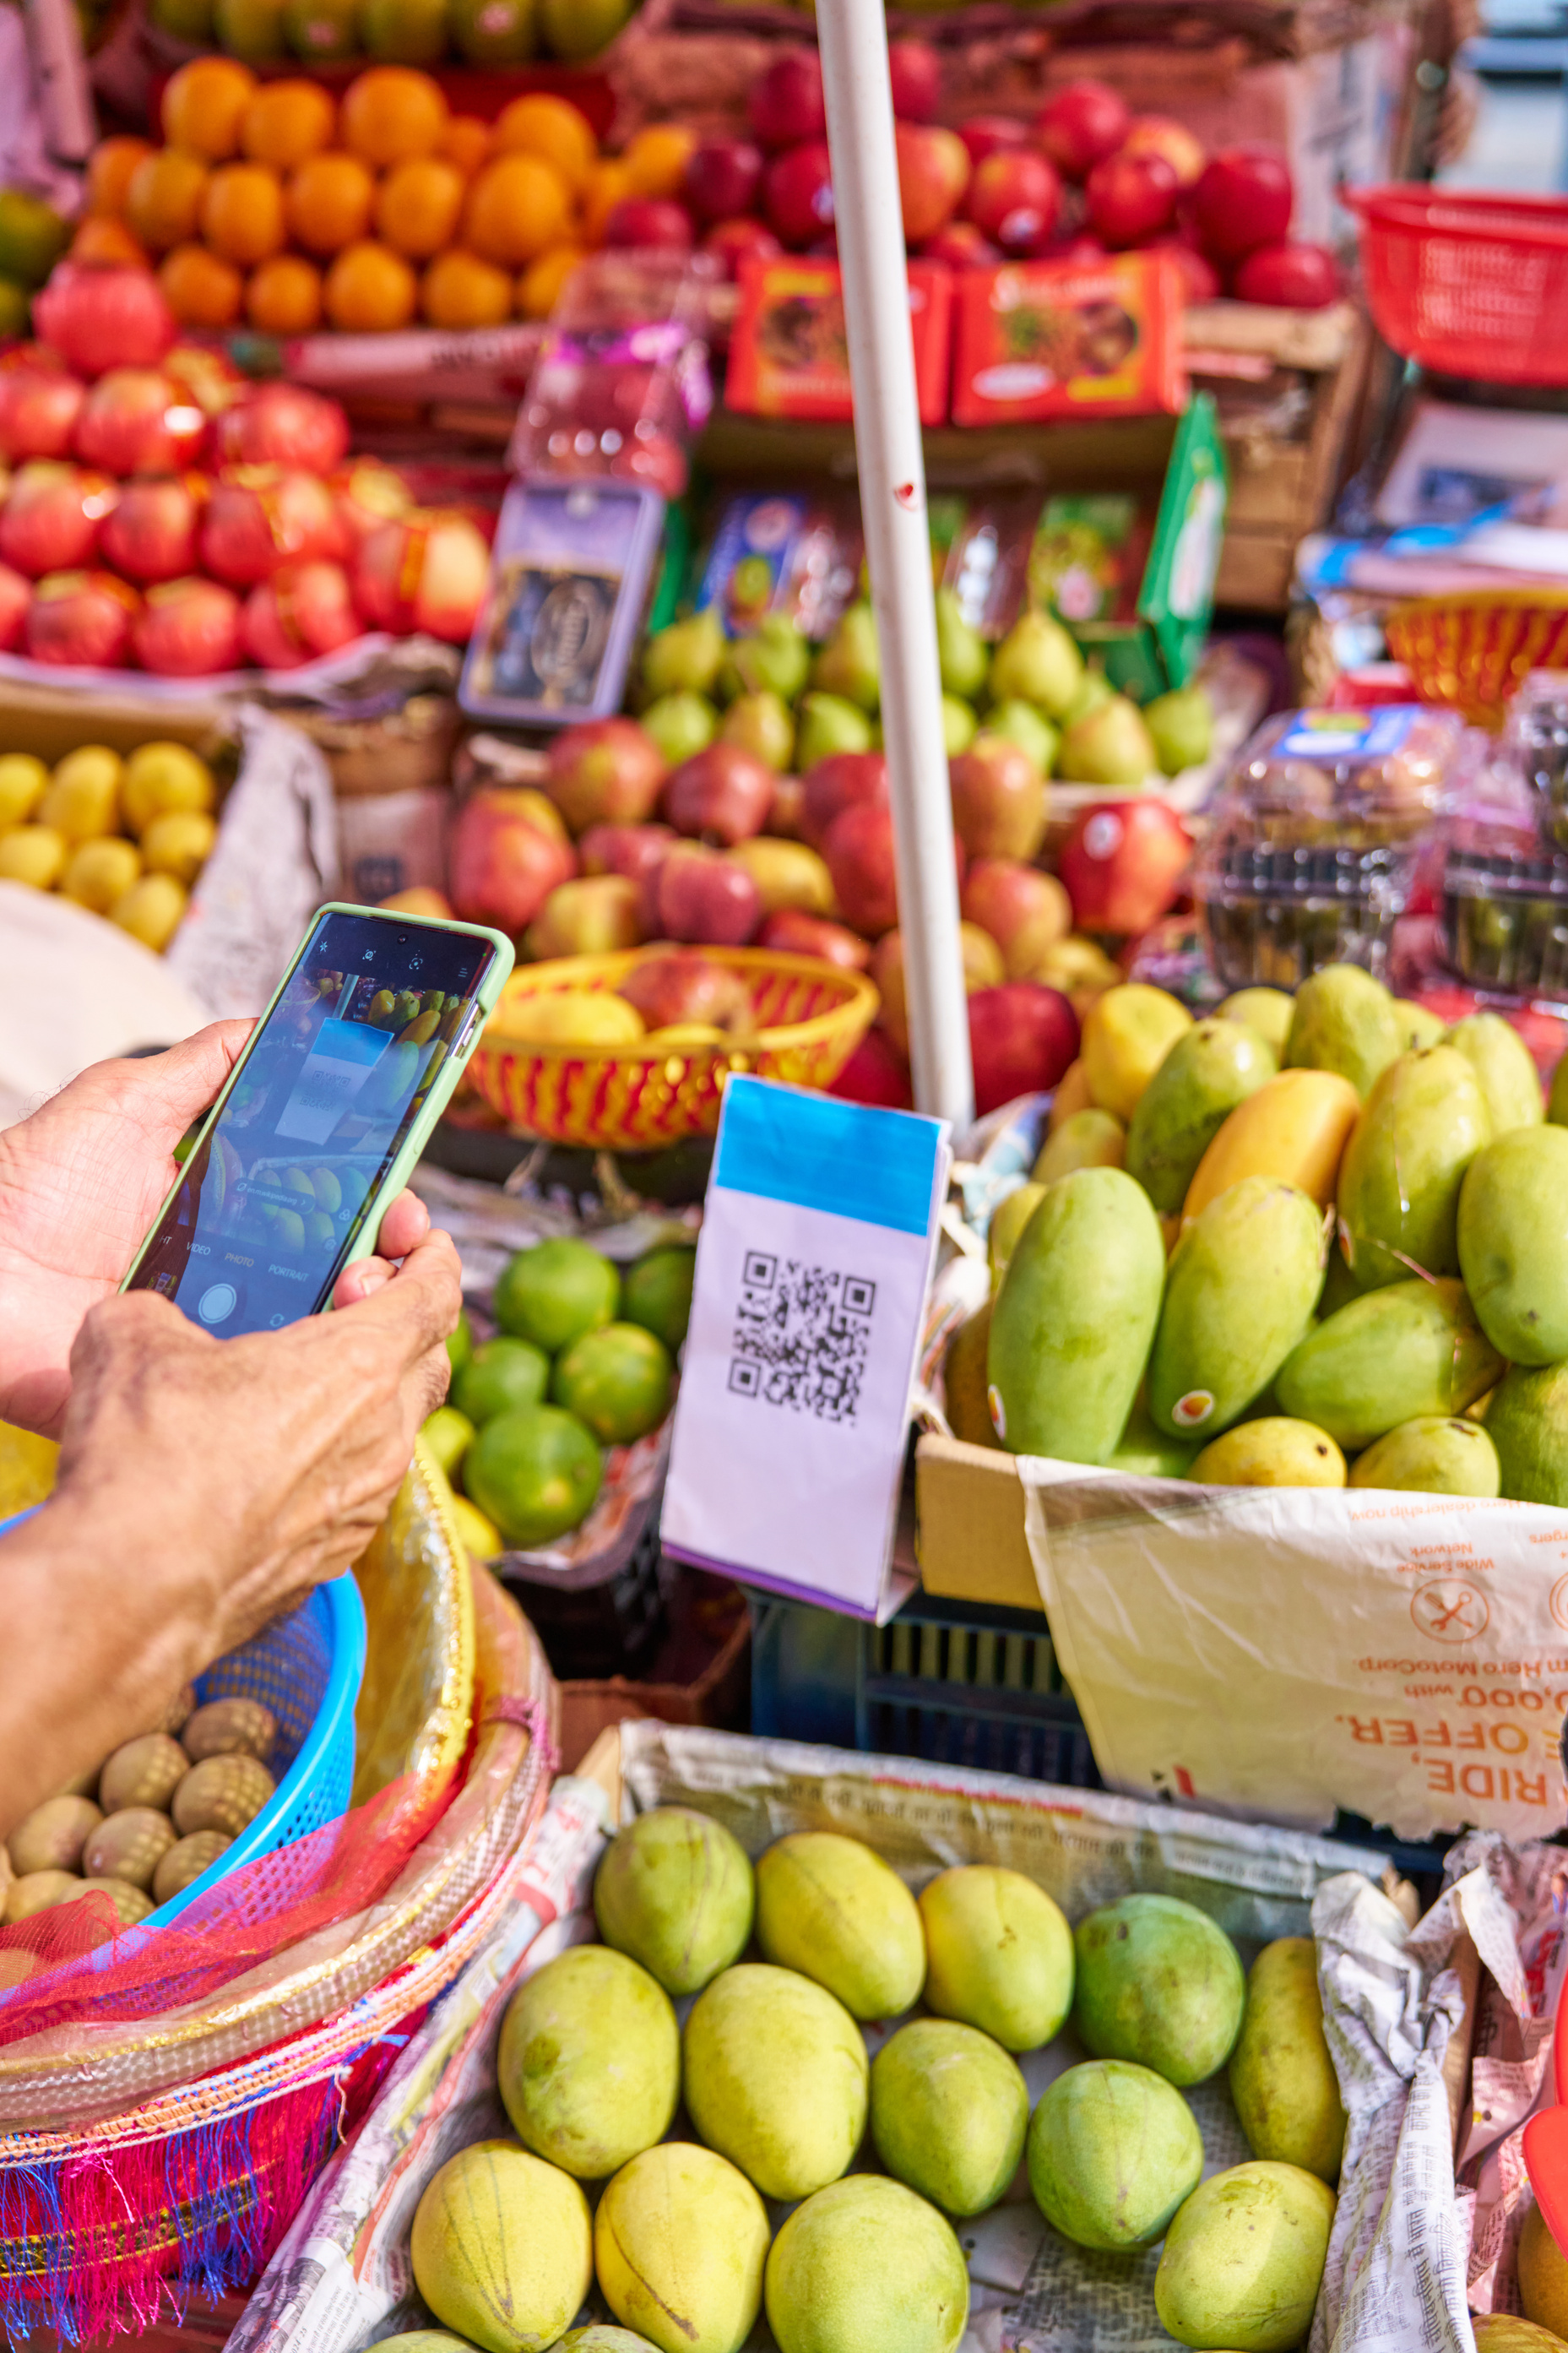
Use Cases
Individual Users:
  Peer-to-peer money transfers
  Bill payments (utilities, telecommunications)
  Online shopping payments
  QR code payments
  Link multiple bank accounts
  Cash top-ups at agent locations merchants
  Earn rewards from referrals and account activity
Business Solutions:
  Retail payment acceptance
  Service provider payments
  E-commerce integration
  Subscription billing
  Staff payroll management
  Vendor payments
  Customer refunds
  Multi-location payment processing
  Bulk disbursements

Slide 11

Use Cases
Agent Network:
  Cash-in/cash-out services
  Bill payment collection
  Increased foot traffic
  Rural area coverage expansion
  Earn commissions
Common Business Use Cases
  Retailers & service providers (QR & card)
  Freelancers & delivery services (links/invoices)
  Schools & training providers (tuition & fees)
  Lenders & finance (disbursements & repayments)
  Marketplaces (split payment & bulk payouts)
  Loyalty programmes

Slide 12
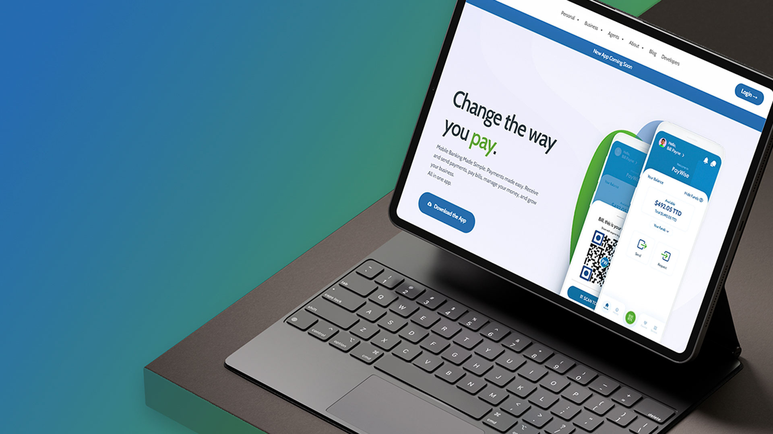
API Platform Capabilities
Outsource Payment Infrastructure, Retain Your Focus
  Single integration point for multiple payment methods
  Supports online global and local payments (debit and credit cards)
  Integrate PayWise into third party systems
  Multiple payment handling and payout options
  Handle transactions, reconciliations, and settlements automatically
  Get comprehensive backend with robust reporting and analytics tools
  Clear, well-documented APIs
  Sandbox testing for seamless onboarding
  Transparent pricing, no hidden fees

Slide 13
3
Pricing Proposal

Slide 14
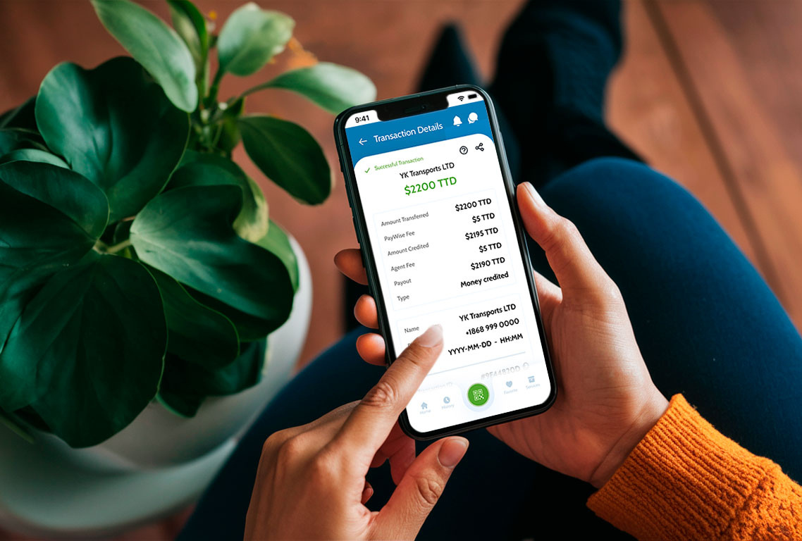
Individual Account
Account Setup: FREE & No Monthly Maintenance
PayWise to PayWise: FREE
Bill Payments: Competitive rates
Wallet Loading: Minimal fees apply
Agent Services: Standard agent fees apply
Business Account
Account Setup:
FREE for registered businesses
No Monthly Fee
Transaction Processing:
  PayWise to PayWise: FREE
  Card Payments: Competitive merchant rates
  Bill Payment Collection: Different fee sharing models
Premium Features:
  Advanced analytics dashboard
  API integration support
  Priority customer support
  Custom payment solutions
  Multi-user account management

Slide 15

Agent Partnership
Registration: FREE
Transaction Commissions: Attractive commission structure
Training & Support: Comprehensive training provided
Marketing Materials: FREE promotional materials
Technical Support: Dedicated agent support team
Fees (At a Glance)
  Pay at Agent: 1% (minimum $8)
  Wallet → Wallet: Free
  Bank Transfer In: Free
  Bank Transfer Out: $2.00
  Bank Transfer Return Fee: $5.00
  Card Fee: 3.5% + $3.00 TTD per transaction
Fees are subject to change. Contact PayWise for enterprise pricing or large‑volume programs.

Slide 16

Value Proposition
Why Choose PayWise?
Regulatory Compliance ✓ Registered with Central Bank of Trinidad and Tobago ✓ FIU registered and compliant ✓ Secure and regulated platform ✓ OPRTT registered
Technology Excellence ✓ Mobile-first design ✓ Real-time processing ✓ Multi-channel payment acceptance ✓ Developer-friendly APIs ✓ Comprehensive reporting
Local Focus ✓ Built for Trinidad & Tobago market ✓ Over 10 years serving T&T ✓ Understanding of local business needs ✓ Extensive agent network coverage ✓ Local customer support
Growth Enabler ✓ Referral rewards program ✓ Business growth analytics ✓ Cashless transaction benefits ✓ Reduced cash handling costs ✓ Improved customer experience

Slide 17

Exploring PayWise Solutions
For Businesses Currently Using Cash:
  Are you losing sales due to customers not having exact change?
  How much time does your staff spend handling cash deposits?
  Are you concerned about theft or loss of cash on premises?
  Would you like detailed analytics on your sales patterns?
  Do customers ask for digital payment options?
For Businesses Using Other Payment Solutions:
  Are you experiencing high transaction costs?
  Do you have full visibility into your payment data?
  Are payments processed in real-time?
  Do you have access to local customer support?
  Can you easily integrate payments with your existing systems?
For Individuals:
  Do you want to earn rewards on your transactions?
  Are you tired of carrying cash everywhere?
  Would you like instant money transfers to friends and family?
  Do you want a simpler way to pay bills?
  Are you interested in supporting local businesses through digital payments?

Slide 18
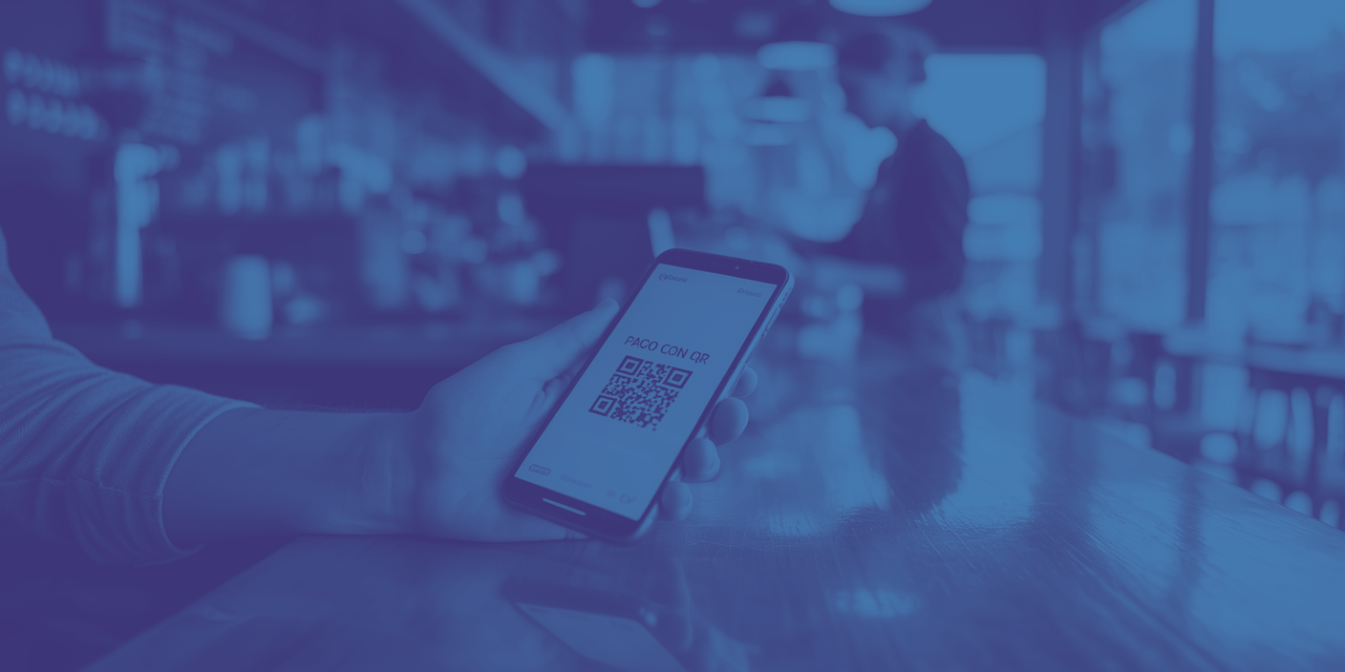
Get Started Today
Download the PayWise Mobile Wallet App Available on Google Play Store and Apple App Store
Visit Our Website www.paywise.co
Contact Our Team
📧 contact@paywise.co
📱 Local customer support available
Follow Us LinkedIn: PayWise Limited
Facebook: @gopaywise
Instagram: @gopaywise

Slide 19

Join the Cashless Revolution
Change the way you pay.
Mobile Banking Made Simple. Payments made easy. Receive and send payments, pay bills, manage your money, and grow your business. All in one app.

Slide 20
Making payments easier with a seamless,
all-in-one payment solution
CONTACT
1-868-610-9323
1-868-723-8394
contact@paywise.co
paywise.co

